Slide 1
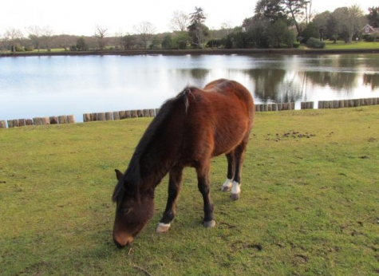
Year 4 Residential
Staff – Mrs Cordey, Mrs Fine and Mr Bowen

Slide 2
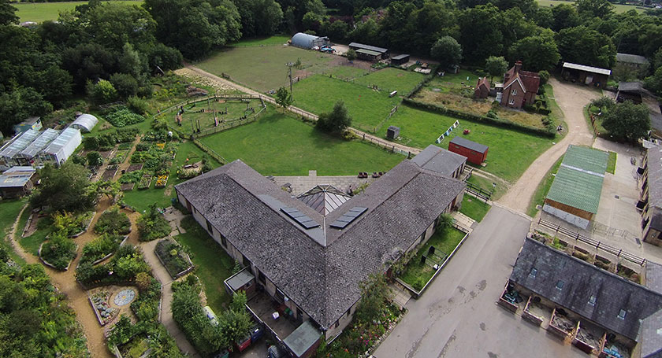
Home Farm Palace Lane, Beaulieu, Brockenhurst, SO42 7YG
“Learning about the countryside,
in the countryside.”

Slide 3
Travel
The coach will leave school at 8pm.
The journey to the Centre will take about 3 hours.
Travel sickness medication.
Wear comfortable clothes/shoes – not school uniform.
Pack a healthy snack/drink for the trip/when we arrive.
Pack a suitcase/bag with wheels.
We aim to return to school at about 4.30pm on Friday.

Slide 4
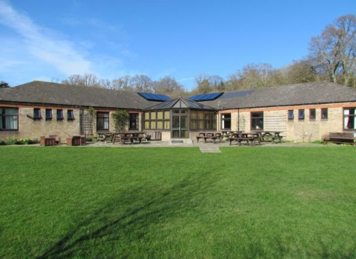
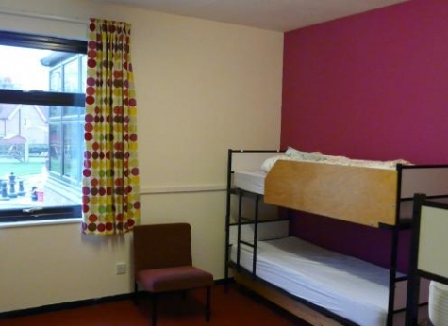
Accommodation
Our school has the whole block.
Pupil rooms sleep 4 - 6.
Shared toilets and showers.
Children can name who they would like to share with.

Slide 5
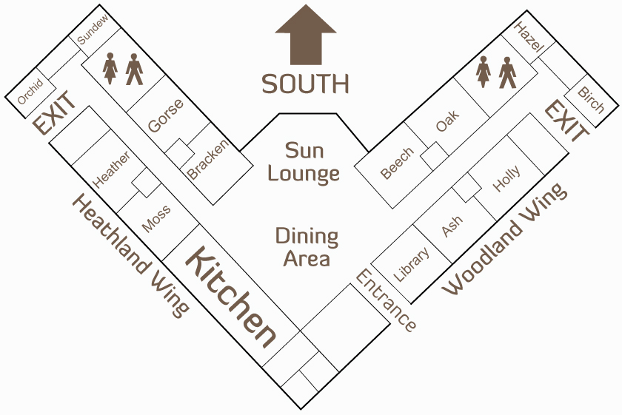
Accommodation
The block has a shared lounge and dining area.
There is a large grassy garden for outdoor recreation, and an adventure playground in sight of the block.

Slide 6
Food
Cooked breakfast and evening meal.
Packed lunch.
Hot soup and rolls, followed by dessert, provided for lunch on day of arrival.
Bedtime drink.
Meals are eaten in the shared dining area.
No food or drink should be consumed in the bedrooms.
All dietary requirements are catered for – please indicate on the medical form.

Slide 7
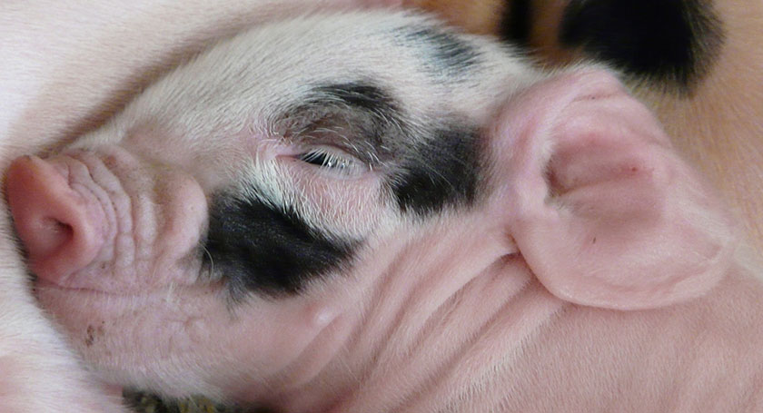
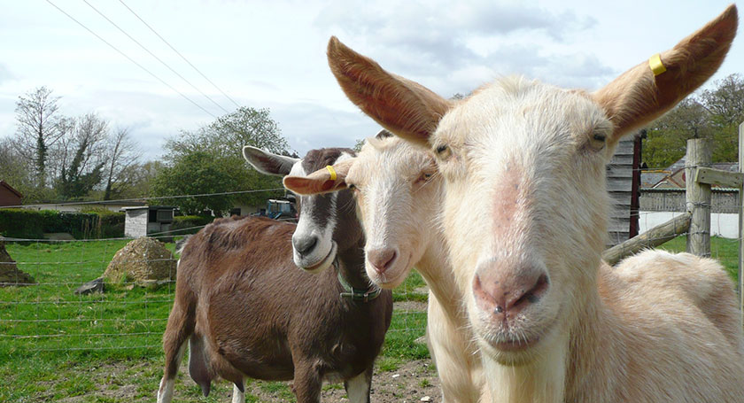
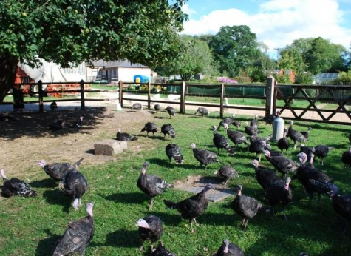
Activities
Farm tour and photo trail.
Survival and shelter building.
Habitat exploration.
Animal feeding.
Gardening.
Weather survey.
Campfire.
Talent competition.

Slide 8
Activities
“Most children have not had the opportunity to stay on a farm. Here at Home Farm, mornings generally start with a snack, followed by chores including cleaning out the animals, collecting eggs or gardening. The children arrive back for breakfast, content that they have already accomplished something useful, and happy to enjoy a home cooked breakfast using produce from the farm and garden.”

Slide 9
Kit list
Waterproof tractor suits and cagoules are provided by the Centre for use on the farm only.
Your child’s luggage should include:
Waterproof coat with a hood
Wellington boots
Hat and suncream
Water bottle
Small rucksack
Enough changes of clothes for 3 days/evenings, including two pairs of shoes/trainers.
Please label all outerwear.
No aerosols or sweets.

Slide 10
Pocket Money
There is a small souvenir shop where the children will be able to buy small gifts.
£3 maximum.
If you would like the teachers to be in charge of the money for your child, they will collect the money in a named envelope/purse on the day of departure.
Electronic Items
Children should not bring mobile phones or other electronic items with them.
Disposable cameras are great.

Slide 11
Medication
All medication should be named and handed to the class teacher on the day of departure in a clearly named box with accompanying instructions.
Fill in the medical form and hand to Mrs Cordey as soon as possible.
If children are travel sick, please inform the teachers and ensure you provide medication for the return journey.
Food allergies – please indicate any allergies and dietary requirements on the medical form.

Slide 12
Contact
Teachers will check in with the school each day.
Parent Mail will notify parents all is well.
Please contact the school in an emergency (during school hours), or the Centre at night.
Children should not have a mobile phone with them.

Slide 13
Countryside Education Trust website www.cet.org.uk
Any questions?

